Slide 1
Macro-Aware Volatility-Targeted ETF Rotation Strategy
FE5209 Financial Econometrics · Group Project
Group: ReReRe (Research Report Reproductor)
Member: Ruan Yalin · Zhang Jiaxin · Zhou Mo · Zhang Yin
Notes:
Good morning everyone. We are [Group Name]. Our project rotates between leveraged, volatility and defensive ETFs in the US, with a small Singapore sleeve. I will cover our motivation and the original US strategy, V0.

Slide 2

Outline
Introduction & Overall Framework
US V0: decision tree and parameter voting
CPI Overlay: Triggers & Execution
US V1 & V2: Risk Controls
Singapore: GARCH-Based Allocation
Final Portfolio, Results & Conclusions
Notes:
Here is the roadmap. I start with V0. Then [Person B] improves it with volatility-based sizing, [Person C] adds Singapore with GARCH forecasts, and [Person D] presents the final portfolio and our October tracking.

Slide 3
Introduction & Overall Strategy
Can dynamic allocation improve performance after trading costs?
US core: V0 equal-vote allocation, then V1 inverse-volatility weights and V2 30% volatility targeting.
Singapore: GARCH forecasts guide ES3 / A35 allocation.
CPI overlay: temporarily replace the V2 TQQQ target with UVXY after qualifying hot CPI releases.
Project at a glance
US core: V0 → V1 → V2
SG: GARCH → ES3 / A35
90% US / 10% SG target
Rebalance if SG is outside 9%–11%
In-sample: 2012-08 – 2019-12
Out-of-sample: 2020-01 – 2026-09
Daily-price simulation: ETF trade costs included; baseline FX conversion cost = 0.
Historical account continues across IS/OOS; October tracking starts separately.
Notes:
Our strategy holds one ETF at a time. Trend, measured by SPY against its moving average, sets the regime, and RSI flags overheated and oversold extremes. Volatility clusters and returns have fat tails, so we test whether this beats the benchmark. The US and Singapore sleeves are two independent capital pools with a 90 / 10 target. After each close we check the Singapore share, and only if it leaves a 9 to 11 percent band do we rebalance, at the next open.

Slide 4
Data & Portfolio Construction
Asset group | Tickers | Class | Role in V0 strategy | Account
Market signal | SPY · QQQ | Equity ETF | Trend (SMA) & RSI signals | US
Leveraged long | TQQQ · TECL · SPXL | Leveraged ETF | Bull / oversold holdings | US
Volatility / inverse | UVXY · SQQQ · TECS | Vol / inverse ETF | Stress holdings (SQQQ: signal) | US
Defensive | BSV | Bond ETF | Defensive holding | US
Singapore | ES3.SI · A35.SI | SG ETFs | Diversifier (equity / bond) | SG
FX | USD/SGD | FX rate | Valuation & funding | Both
Daily
6,336
US: opening bid–ask-based estimates
SG: 10 bps per side
adjusted prices; core trades at next open
parameter sets, one vote each
Transaction costs
Notes:
Our signals use SPY, QQQ, SQQQ and TECS. The strategy can hold TQQQ, TECL, SPXL, UVXY, TECS or BSV. Singapore adds ES3 and A35. We use daily adjusted prices, and one-way costs from half a basis point to 35 basis points.

Slide 5
US V0 Strategy: One Decision Tree
1 SPY > long-term SMA?
Yes
QQQ or SPY RSI > overheat?
Yes: UVXY No: TQQQ
No
2 TQQQ RSI < oversold?
Yes
Select TECL
No
SPY RSI < oversold?
Yes
Select SPXL
No
3 fear < UVXY RSI ≤ extreme?
Yes
Select UVXY
No
4 Choose the trend filter: extreme fear → QQQ; otherwise → TQQQ
Price > SMA20: TECS if SQQQ RSI < line; otherwise TECL.
Price ≤ SMA20: higher RSI of TECS / BSV (tie: TECS).
Notes:
This is V0, one decision tree. If SPY is above its moving average, it is a bull market: hold TQQQ, or UVXY if RSI says overheated. Otherwise, if RSI is oversold we buy TECL or SPXL; if UVXY signals fear we hold UVXY; and on other days a 20-day trend filter chooses TECL, TECS or BSV.

Slide 6
Ensemble: 6,336-Parameter Voting
1
2
3
4
Grid
Filter
Vote
Execute
7 parameters, 3–4 values each: 6,912 combinations
Keep UVXY extreme > fear: 6,336 valid sets
Each set picks one ETF; weight = votes / 6,336
Signal at close T, trade at open T+1, after costs
Grid: RSI window 7 / 10 / 14 · SPY SMA 100 / 120 / 150 / 200 · overheat 70 / 75 / 80 / 85 · oversold 20 / 25 / 30 / 35 · UVXY fear 64 / 70 / 74 / 80 · UVXY extreme 80 / 84 / 88 · SQQQ line 30 / 34 / 38
RSI and trend-filter background: Wilder (1978), Brock et al. (1992), and Faber (2007). UVXY / SQQQ thresholds come from the original code. Equal voting reduces dependence on one setting.
Notes:
But one parameter set is fragile. So we vary seven parameters, such as the RSI window, the SPY moving average and the thresholds. That gives 6,912 combinations, and removing those where the extreme level is not above the fear level leaves 6,336. Each set votes for one ETF, and the weight is votes divided by 6,336. For example, 4,752 votes for TQQQ means a 75 percent weight. Signals come at the close, and we trade at the next open, inside the US pool, after costs. [Person B] will now improve the risk profile.

Slide 7
7
CPI Overlay: Role & Trigger Conditions
Role: a short-term event adjustment to US V2
Temporarily replace TQQQ with UVXY to address post-CPI market stress.
Otherwise follow V2. Singapore allocation rules stay unchanged.
Activate only when ALL three conditions hold:
1
Current actual CPI YoY > forecast.
2
Previous published actual CPI YoY ≥ 3%.
3
Prior directional hit rate ≥ 70%.
Use up to 16 releases where actual differs from forecast (minimum 8).
Hit: CPI above forecast + QQQ opens lower, or
CPI below forecast + QQQ opens higher (vs previous close).
ReReRe · FE5209 Financial Econometrics

Slide 8
8
CPI Overlay: Execution & Return to V2
1
Release day
Check the actual / forecast CPI and both historical gates.
2
Days 1–3, US open
At each open, move the entire current V2 TQQQ target to UVXY.
Keep other target weights unchanged.
3
Day 3, US close
Restore the baseline V2 target known before that day’s open.
Keep any UVXY that baseline V2 requires.
Example: US-account target weights
V2: TQQQ 50% / UVXY 10% / BSV 40%
Overlay: TQQQ 0% / UVXY 60% / BSV 40%
ReReRe · FE5209 Financial Econometrics

Slide 9
US V1 & V2: Risk Controls
Notes:
Since Jessie has already told you about the US market, I‘ll walk you through our Singapore sleeve.

Slide 10
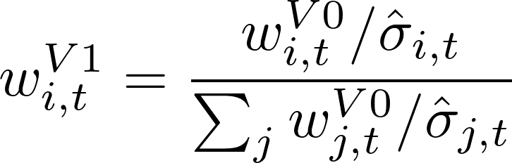
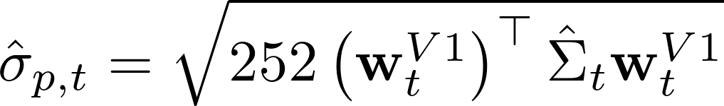
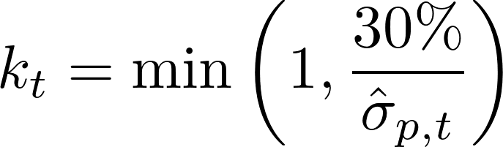
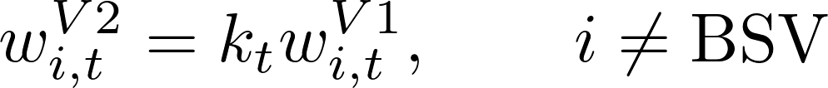
US Strategy | From Signals to Risk Control
Three decisions: what to buy → how to allocate → how much risk to take
V0 · SIGNAL
V1 · REWEIGHT
V2 · RISK BUDGET
6,336 parameter votes
60-day inverse volatility reweight
30% annual volatility target
TQQQ concentration risk
Can still hold 100% TQQQ
Unallocated exposure → BSV
STEP 1 · 60-day inverse volatility reweight
STEP 2 · Estimate V1 portfolio risk
STEP 3 · Scale risky ETF exposure; put the residual into BSV
Example: 100% TQQQ at 60% estimated volatility → 50% TQQQ + 50% BSV.
Notes:
Building on our original strategy, we introduced two risk management improvements.
First, V1 uses 60-day inverse-volatility weighting to reduce exposure to highly volatile ETFs.
However, it cannot address extreme concentration in TQQQ. If TQQQ receives 100% of the original allocation, V1 cannot reduce its weight.
Therefore, V2 introduces a 30% volatility target. When estimated risk exceeds this target, we reduce risky ETF exposure and allocate the remaining weight to BSV, a short-term Treasury bond ETF.
This allows us to control overall portfolio risk.

Slide 11
US Strategy | Backtest Results
Out-of-sample backtest · 2020 to 30 Sep 2026 · same trading costs
Metric
V0 Original
V1 Inverse Vol
V2 · 30% Target
CAGR
115.56%
102.46%
45.91%
Annualized volatility
59.38%
55.78%
30.08%
Sharpe ratio
1.5893
1.5457
1.4114
Maximum drawdown
−49.06%
−44.64%
−26.97%
V2 reduces volatility by 29.30 pp and drawdown magnitude by 22.09 pp vs V0.
Trade-off: Lower risk, but lower CAGR and Sharpe. | 30% is a target, not a guarantee.
Notes:
Now, let's look at our out-of-sample results.
With V2, annualized volatility decreased from 59% to 30%, while maximum drawdown improved from 49% to 28%.
Although this reduced our returns, downside protection is especially important when trading leveraged ETFs.
We also tested volatility targets ranging from 30% to 60%.
After comparing these alternatives, we selected 30% as our preferred risk-return trade-off, balancing return potential with downside protection.
This reflects our emphasis on maintaining a more controlled risk profile rather than simply maximizing returns.

Slide 12
Singapore Market & GARCH
Notes:
Since Jessie has already told you about the US market, I‘ll walk you through our Singapore sleeve.

Slide 13
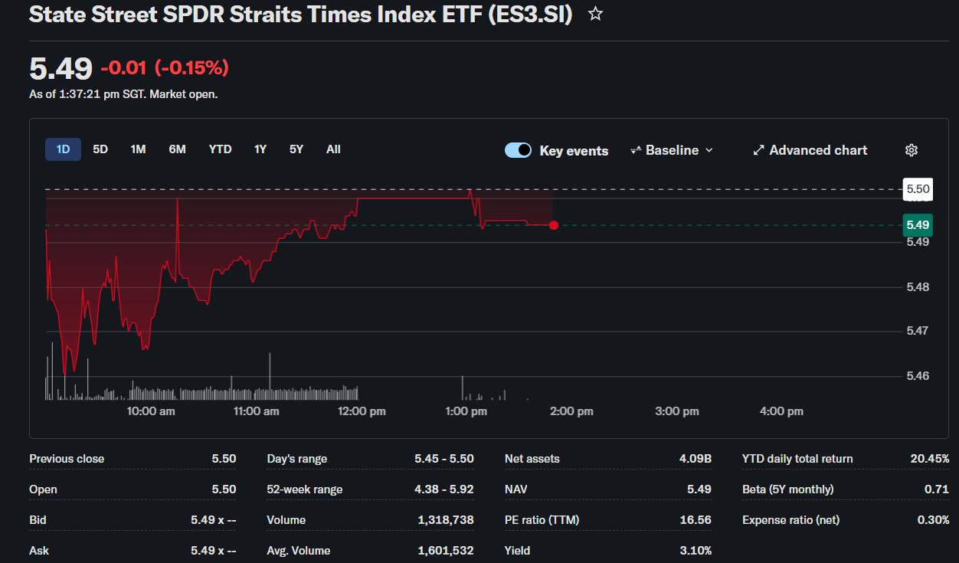
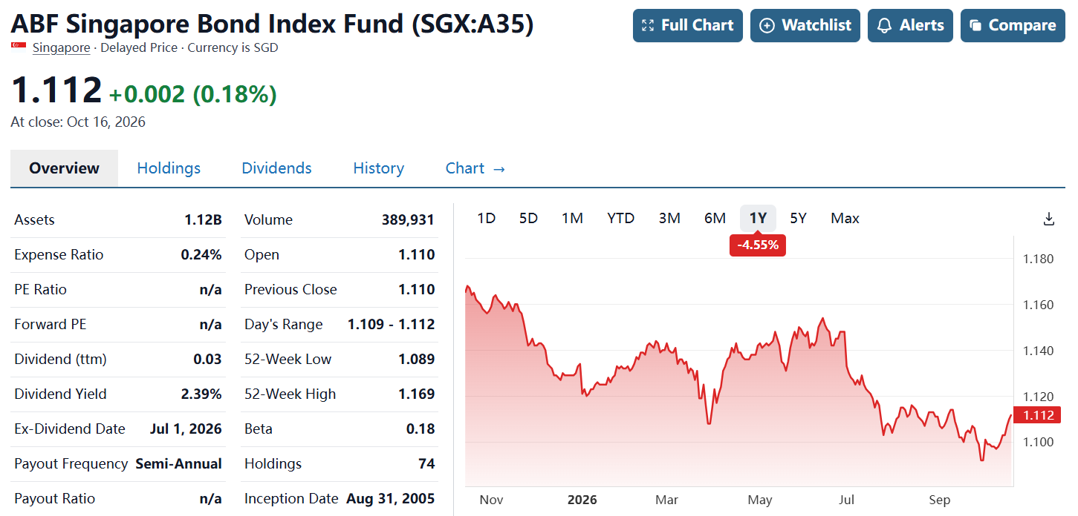
Singapore Sleeve
Assets: ES3.SI (SPDR STI ETF) + A35.SI (ABF Singapore Bond Index Fund)
“boring but reliable” portfolio
And honestly, in investing, boring is a compliment.
Q: How much ES3 should we hold each day ?
Notes:
We only use two ingredients.
The first is ES3, the STI ETF. It basically holds the 30 biggest companies in Singapore, so it’s our “exciting” asset.
The second is A35, the Singapore Bond Index Fund, which is mostly Singapore government bonds.
Mix the exciting one with the safe one, and you get our “boring but reliable” portfolio.
And here comes the whole question: how much ES3 should we hold each day?

Slide 14
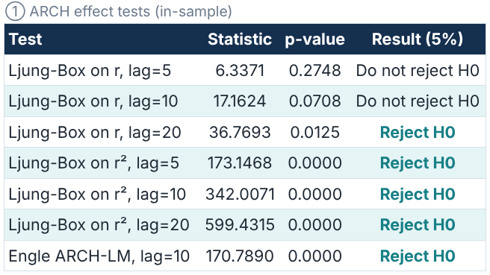
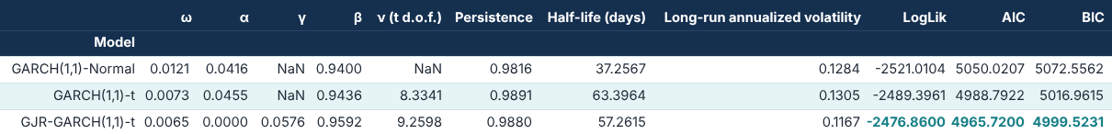
Singapore Strategy:How much ES3 should we hold each day ?
Q: How risky ES3 will be tomorrow?
Returns: no autocorrelation
Squared returns: strong autocorrelation
volatility clustering
GARCH
GJR-GARCH(1,1)-t √
Notes:
To answer that, we need to know how risky ES3 will be tomorrow. Reviewing from the class, volatility clustering usually happens, and our ARCH tests confirmed ES3 has it, and that’s the reason we use GARCH.
We tried three versions of GARCH, let BIC pick the best one, and refit it every month using only past data.

Slide 15

Singapore Strategy:How much ES3 should we hold each day ?
Assets: ES3.SI (SPDR STI ETF) + A35.SI (ABF Singapore Bond Index Fund)
$ES3 weight=\min\left(\frac{σ_{target}}{{\hat{σ}}_{GJR−GARCH(1,1)−t}}, 1\right)$
A35 weight = 1-ES3 weight
stock↓ bonds↑
stock↑ bonds↓
We only rebalance when the weight changes by more than 10 percentage points.
Notes:
Now the position rule, which fits on one line:
We define,ES3 weight = target volatility divided by forecast volatility.
The rest goes into A35.
Intuitively, when GARCH says “storm coming,” we hold less stock and more bonds. When it says “sunny skies,” we move back into stocks. No leverage, ever.
One practical detail. We only rebalance when the weight changes by more than 10 percentage points, so we don’t burn money on trading costs.
In short: we don’t predict where the market goes. We just predict how bumpy the ride will be, and adjust our seatbelt.
Here is all for the Singapore market, and lets invite Lorraine to combine the two markets together.

Slide 16
Final Portfolio, Results & Conclusions
Notes:
Since Jessie has already told you about the US market, I‘ll walk you through our Singapore sleeve.

Slide 17
Backtest vs QQQ and SPY
Period | Metric | Final strategy | QQQ | SPY
IS 2012-08 – 2019 | CAGR / Sharpe / MDD | 28.2% / 1.06 / −39.2% | 18.7% / 1.16 / −22.8% | 14.3% / 1.10 / −19.3%
OOS 2020 – 2026-09 | CAGR / Sharpe / MDD | 45.0% / 1.46 / −24.0% | 20.7% / 0.89 / −35.1% | 15.2% / 0.80 / −33.7%
OOS excl. 2020 | CAGR / Sharpe / MDD | 35.2% / 1.24 / −24.0% | 17.1% / 0.82 / −35.1% | 14.7% / 0.90 / −24.5%
Read-out
Out of sample 45.0% a year, Sharpe 1.46, max drawdown −24.0% vs SPY 15.2%, 0.80, −33.7%
Excluding 2020: 35.2% a year, Sharpe 1.24 vs SPY 14.7%, 0.90
In-sample Sharpe 1.06 is below QQQ’s 1.16 and the drawdown is deeper (−39.2%): no in-sample edge
CPI overlay: OOS 43.5% → 45.0% a year, Sharpe 1.45 → 1.46; drawdown unchanged; never triggered in-sample
KEY POINT Out of sample: higher Sharpe and a shallower drawdown than QQQ and SPY. In-sample: no edge. The CPI overlay adds little.
Source: team backtest (Report.html, final_metrics.csv); QQQ from the team’s earlier backtest. 90/10 start, ±1 pt reset, costs included. OOS 2020 – 2026-09
Notes:
Good afternoon. Let me walk you through our final portfolio. It is entirely rules-based. Ninety percent goes into a US ETF rotation that targets thirty percent volatility, with a short-term hedge after hot CPI releases. The other ten percent goes into a Singapore sleeve, where a GARCH model sizes the risk.
Now, the results. In sample, from 2012 to 2019, we earned 28.2 percent a year, roughly double SPY.
Out of sample, from 2020 to September 2026, the picture changes. We earned 45.0 percent a year, with a Sharpe of 1.46 and a maximum drawdown of 24 percent. SPY earned 15.2 percent, with a Sharpe of 0.80 and a drawdown of 34 percent. And it’s not just 2020: excluding that year, we still earned 35.2 percent. All of this is after costs.

Slide 18
Test-Period Performance
1 Oct 2026 – 20 Oct 2026 · 14 trading days · +7.66% vs SPY +0.27%, QQQ −3.27%, TQQQ −10.46%
Metric | Value | Meaning
Total Return | +7.66% | Ending equity USD 107,664 from USD 100,000, after costs
Annualised (CAGR) | +277.8% | 14 days compounded to 252; not a forecast
vs Benchmarks | SPY +0.27% | QQQ −3.27%, TQQQ −10.46% (same window)
Max Drawdown | −3.78% | SPY −2.03%, QQQ −6.56%, TQQQ −19.04%
Annual Volatility | 31.3% | Std. dev. of daily returns, annualised (14 daily returns)
Best / Worst Day | +6.41% / −1.96% | Best: 16 Oct (CPI hedge exit); worst: 8 Oct
Positive Days | 8 of 14 | Share of trading days with a gain
Drawdown Episodes | 1 | Peak 6 Oct, trough 13 Oct, recovered 16 Oct
Number of Trades | 61 | Fills at the next open; one close-price exit on 16 Oct
Trading Cost | USD 161.75 | About 0.16% of capital; traded notional USD 526k (5.3×)
Current Allocation | US 91.1% / SG 8.9% | TQQQ 49.7%, BSV 41.4%, ES3 6.1%, A35 2.7% (20 Oct)
Account: USD 100,000, initial 90% US / 10% SG, own cash per sleeve; fills at next open; costs included. The CPI overlay triggered once (14 Oct): without it the same account was −6.04% (max drawdown −10.27%), so the October gain rests on one trigger.
Notes:
Next, the test period. We ran a separate simulated account, starting with one hundred thousand dollars on the first of October, with every trade filled at the next real opening price. After fourteen trading days, we are up 7.66 percent. For comparison, SPY is up 0.27 percent, and QQQ is down 3.27. Our maximum drawdown was 3.78 percent.

Slide 19
Conclusion
Results: out of sample (2020 – Sep 2026) the strategy earned 45.0% a year with Sharpe 1.46 and max drawdown −24%, vs SPY 15.2%, 0.80 and −34%; QQQ Sharpe 0.89, drawdown −35%
Not just 2020: excluding it, 35.2% a year (Sharpe 1.24) vs SPY 14.7% (0.90); all figures are after trading costs
Test period: 1 – 20 Oct 2026 the live-style account is +7.66% (SPY +0.27%), but −6.04% without the CPI overlay: one trigger
Process: every trade follows a fixed rule and fills at the next real open; the Singapore share is reset to 10% only outside a ±1 pt band
Caveats: in sample no Sharpe or drawdown advantage in sample over buy-and-hold; the CPI overlay triggers only 9 times
KEY POINT Out of sample, nearly 3× SPY’s return with a shallower drawdown; rules-based and fully auditable. The CPI overlay is a small add-on.
Source: team backtest and October tracking (Report.html: final_metrics.csv, final_live_summary.csv); QQQ from the earlier backtest
Notes:
To conclude, this is a rules-based, risk-controlled and fully auditable strategy. Out of sample, it delivered nearly three times SPY’s return, with a shallower drawdown.
But we need to confirm, there are limits. In sample, we showed no advantage on Sharpe or drawdown. The CPI overlay has triggered only nine times. And our costs are modelled from daily prices, not from broker fills.

Slide 20
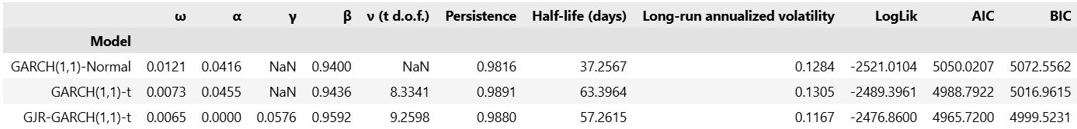

Singapore Strategy: Why GJR-CARCH?
GARCH(1,1)
$$h_{t}=a_{0}+a_{1}ε_{t−1}^{2}+b_{1}h_{t−1}$$
GJR-GARCH(1,1)-t
$$h_{t}=a_{0}+a_{1}ε_{t−1}^{2}+γI_{t−1}ε_{t−1}^{2}+b_{1}h_{t−1}$$
$$I_{t−1}=\left\{\begin{aligned}1,ε_{t−1}<0 \\ 0,ε_{t−1}≥0\end{aligned}\right.$$
Notes:
Let’s start with plain GARCH(1,1). Intuitively, tomorrow’s risk = a long-run average + yesterday’s surprise + yesterday’s risk.
But plain GARCH has one blind spot. It squares yesterday’s surprise, so the sign disappears: a 2% jump scares it just as much as a 2% drop. But it is not like the reality. Because in reality people always think I derserve the gain and lose should be attributed to the environment. So if there is a loss, it will cause some panic.
GJR-GARCH fixes this with one extra term, gamma, which only switches on after a bad day. So for ES3, good news doesn’t raise tomorrow’s risk at all. Bad news does all the work. Markets, like people, remember insults much longer than compliments.
No need to say much about the t-distribution, because the reality always has the fat-tail.

